Slide 1
Naybrr
Josh Cormier
Jamila Sisco

Slide 2
Naybrr
App for local buying and selling
Can order from multiple people at once
Neighbors (Users) can manage directly and get paid

Slide 3
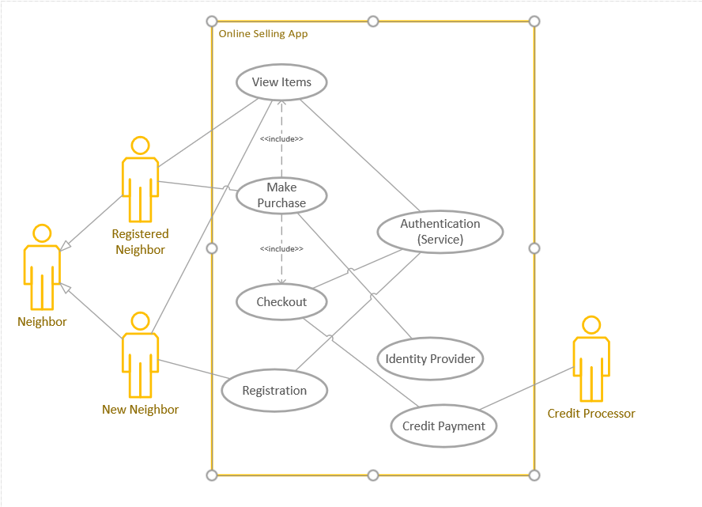
Use Case
Neighbor
Sign Up or Log In
Make Purchase
Sell
Checkout

Slide 4
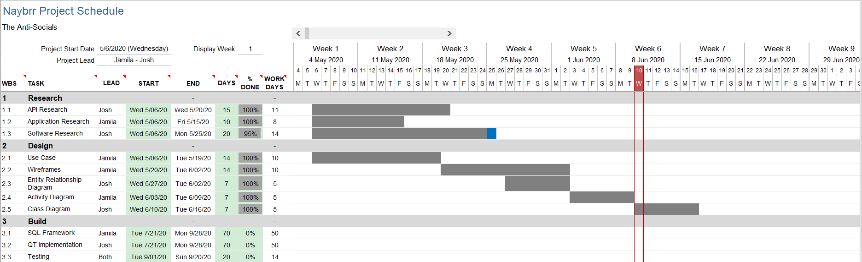
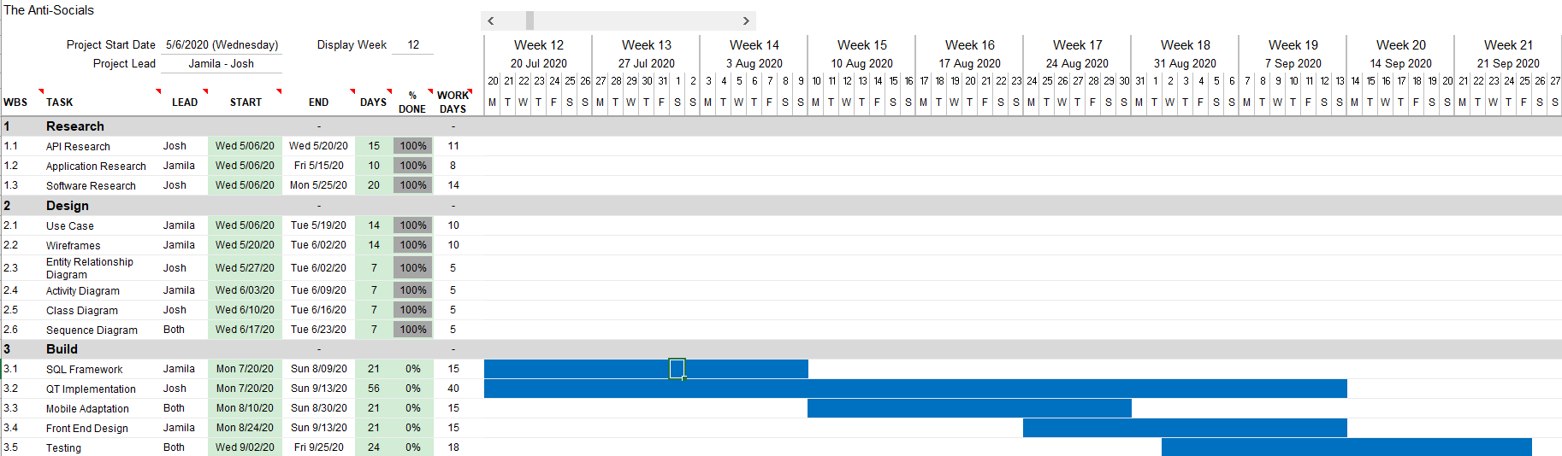
Timeline

Slide 5





Software

Slide 6
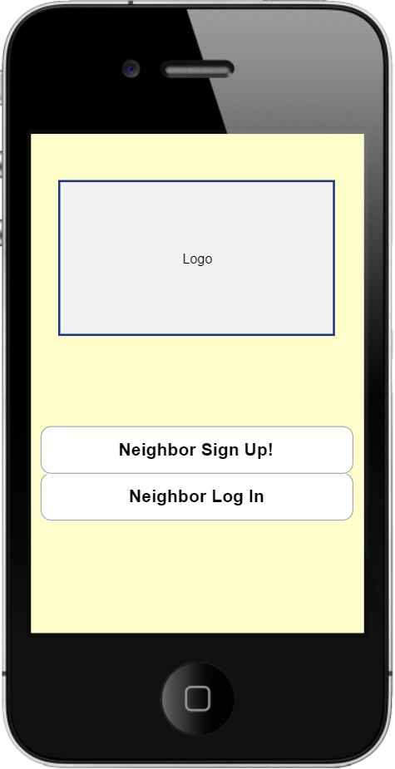
Home Page

Slide 7
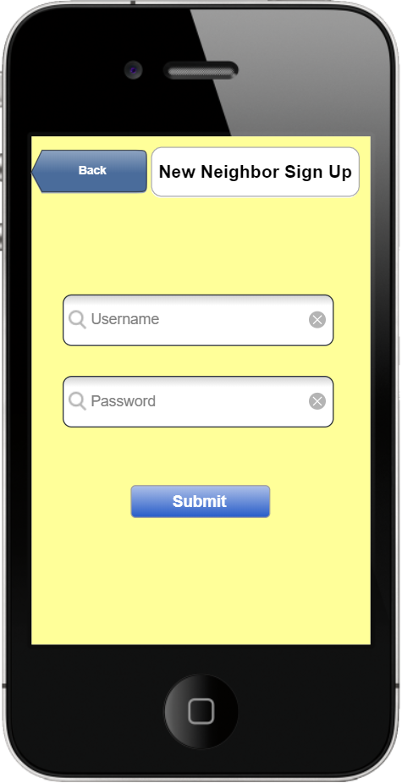
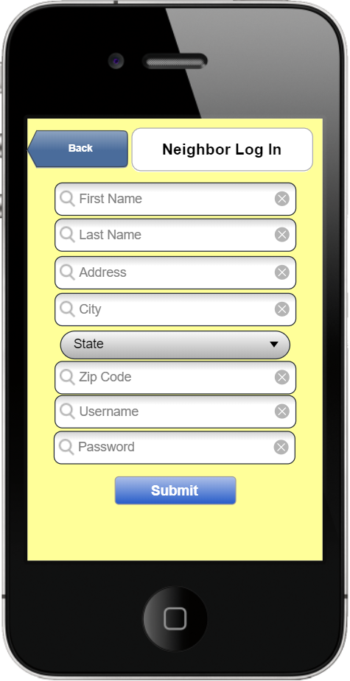
Log In Sign Up

Slide 8
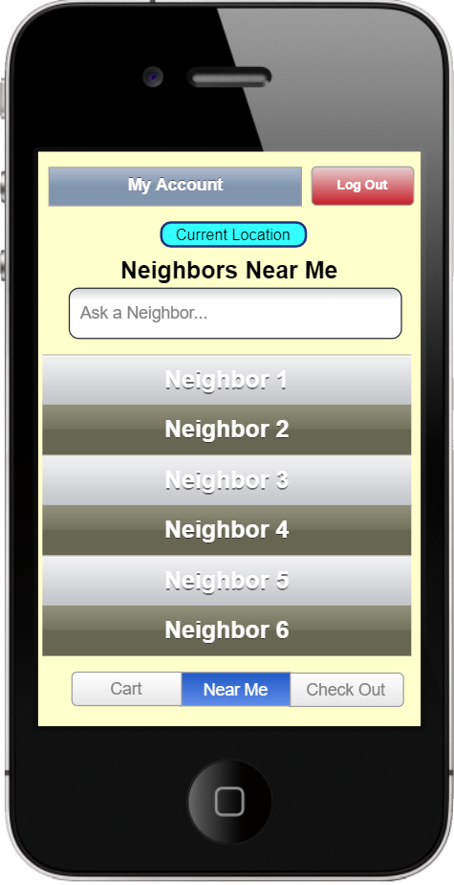
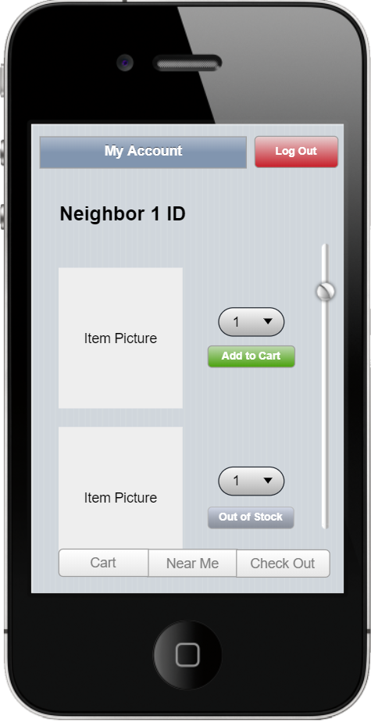
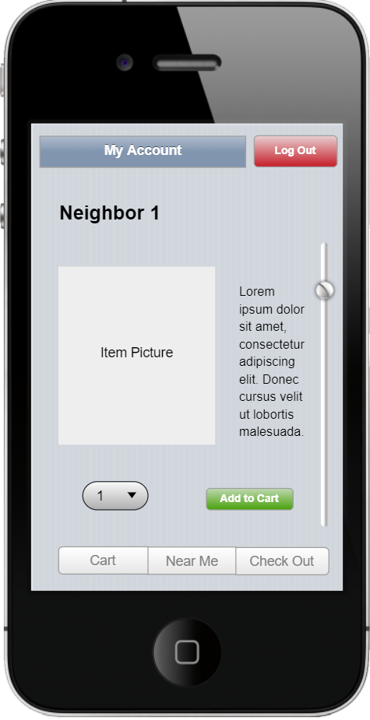
Neighbor Portal

Slide 9
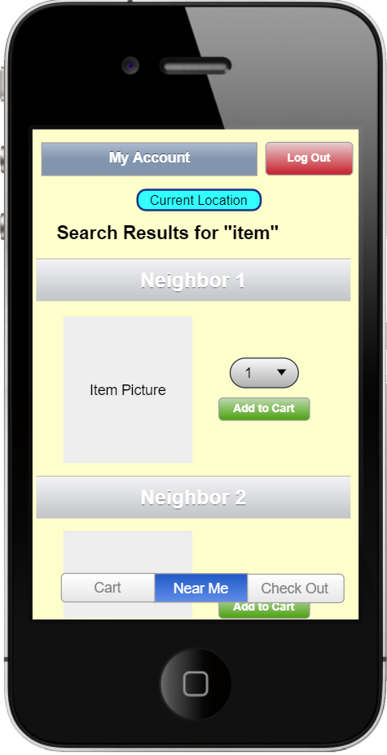
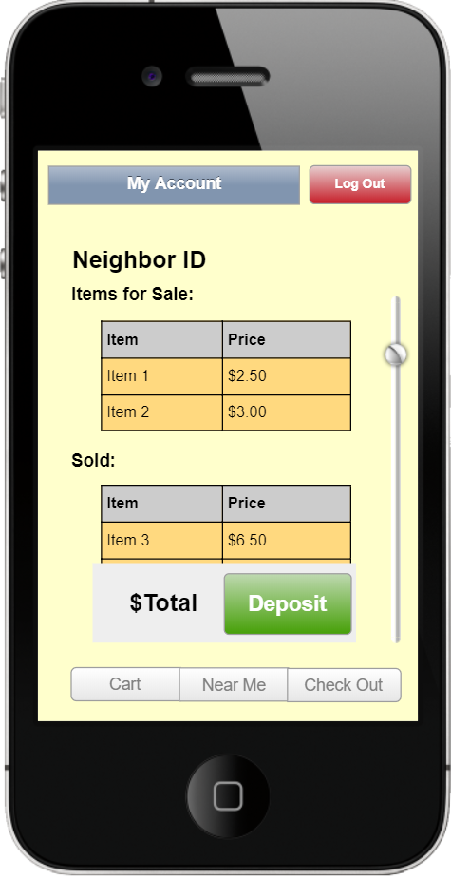
Search Balance

Slide 10
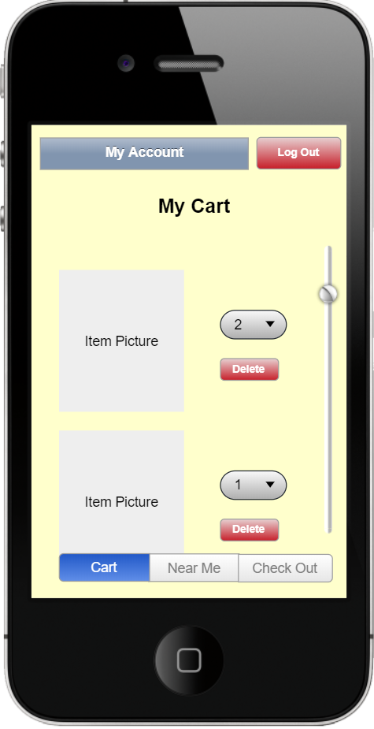
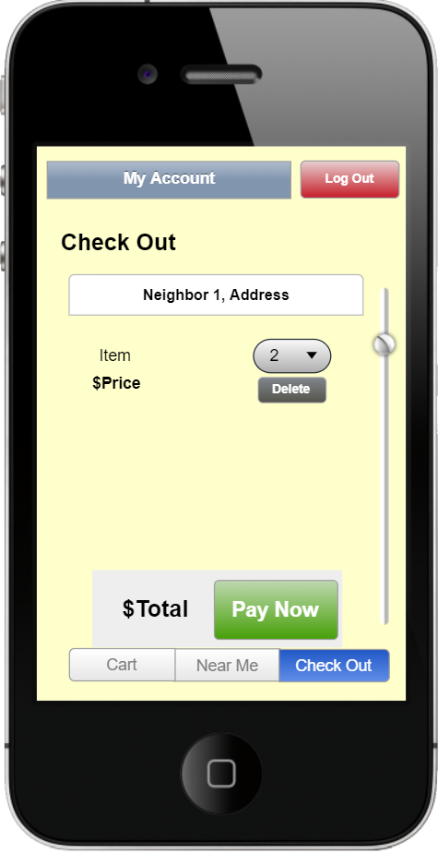
Cart Check Out

Slide 11
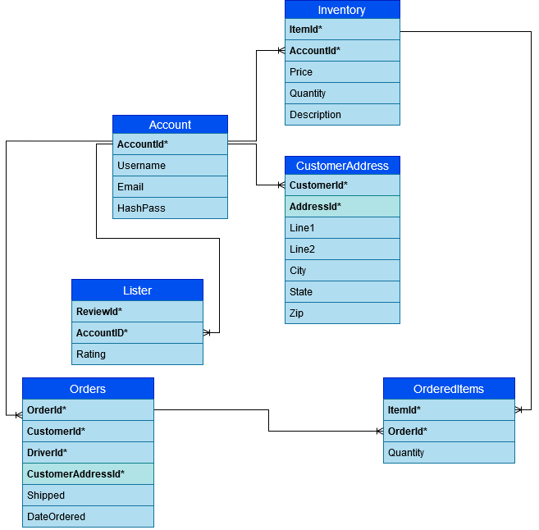
Entity Relationship Diagram

Slide 12
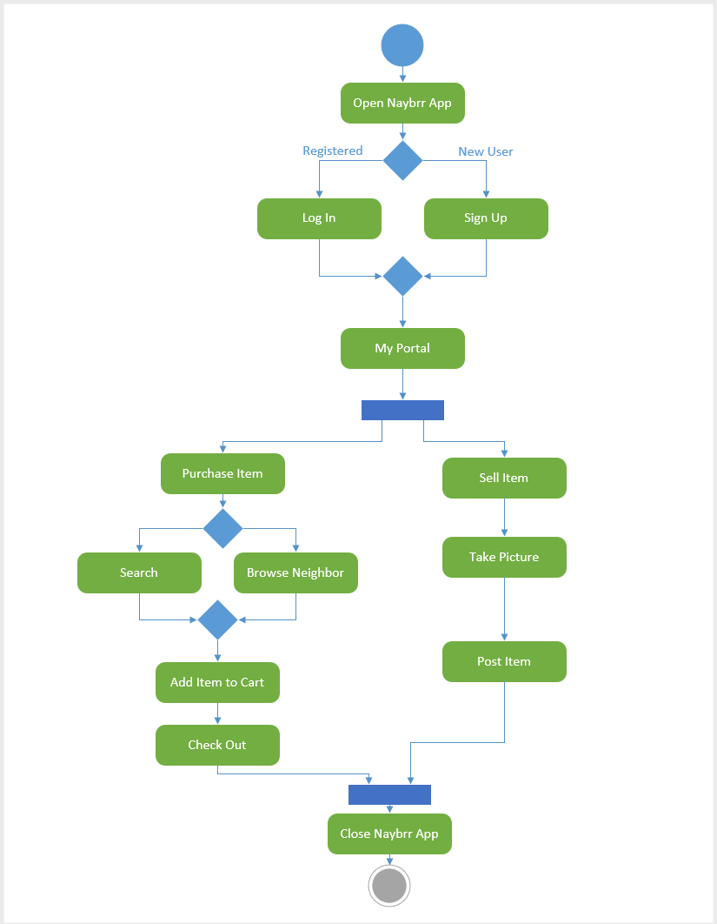
Activity Diagram

Slide 13
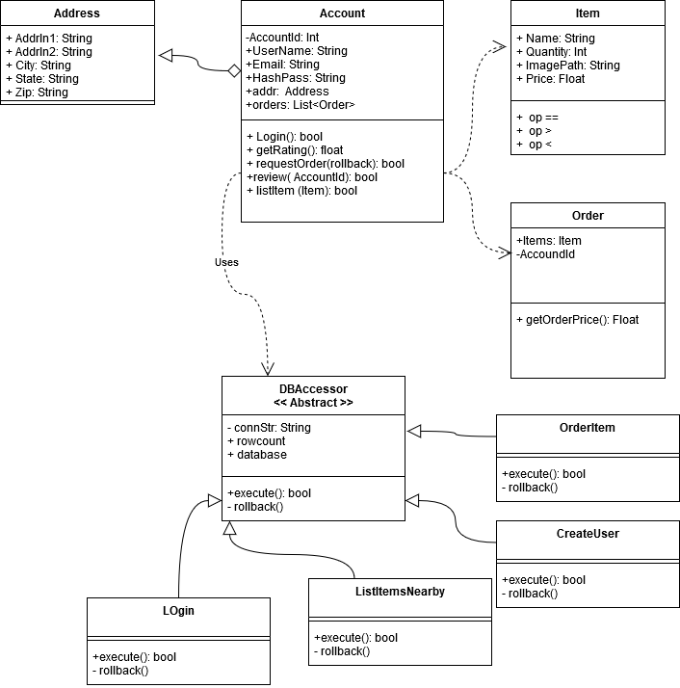
Class Diagram

Slide 14
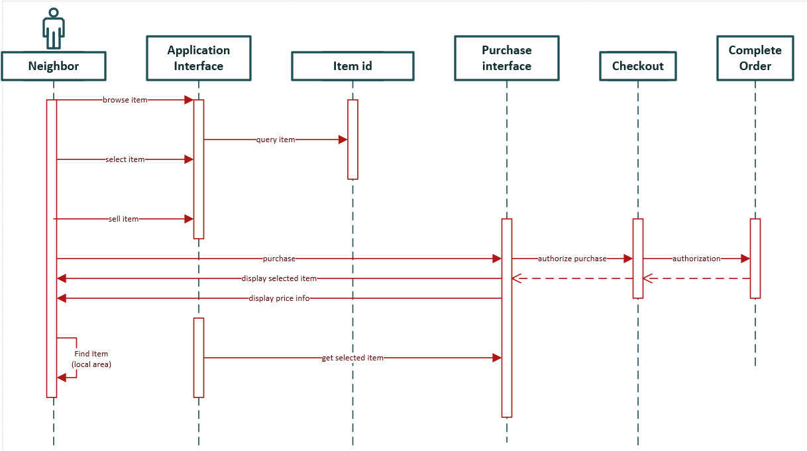
Sequence Diagram

Slide 15
Questions?

